Slide 1



THE NEED FOR DATA GOVERNANCE:
A CASE STUDY
Presented by:
Bolormaa Mendbayar
Saket Abhaykumar
Temitope oladimeji
Thapelo Khantsi
Reyna Vargas
Ziyi Yan
Notes:
Introduction:
In this presentation we will be talking about the paper ‘The Need for Data Governance’ that was written by Lai Kuan Cheong, Vanessa Chang and published in the 18th Australasian Conference on Information System’ for the December issue of 2007.
The Need for Data Governance is published by the Research Gate for the managers of enterprise information management. Some of the areas addressed in this paper include Importance of data quality, It and Data governance, Data management issues, Data governance structure etc.
Relevance to the course so far:
In week 1 of the module, we covered data governance concepts, definitions, and the importance of trusted data for digital transformation. And we learned why trusted data is the key digital transformation, we had an example of poor corporate and research data governance. The case study aligns with the course's focus on the scope, roles, responsibilities, and implementation of data governance models​

Slide 2



Introduction of the paper
Organizations needed to demonstrate the accuracy and integrity of their financial and operational data, making Data Goverance essential.
Data quality problems, including inaccuracies, inconsistencies, lack of timely data resulted in poor decision-making and operational inefficiencies.
Collaboration between domains to ensure that data management practices aligned wth business objectives and regulatory requirements.
The authors aimed to investigate Intersection of IT Governnace and Data Governance, examining how established frameworks like COBIT and COSO could be leveraged tpo develop robust Data Governance practices.
Notes:
The primary reason behind Cheong and Chang's investigation into the need for Data Governance, as detailed in their paper, was to address the growing recognition of data as a critical corporate asset and the emerging challenges in managing data quality. Several specific motivations led to this investigation:
The increasing regulatory requirements, such as the Sarbanes-Oxley (SOX) Act, necessitated stringent data management practices to ensure compliance. Organizations needed to demonstrate the accuracy and integrity of their financial and operational data, making Data Governance essential.
Many organizations were facing significant data quality problems, including inaccuracies, inconsistencies, and lack of timely data. These issues often resulted in poor decision-making and operational inefficiencies. The authors aimed to explore how structured Data Governance could mitigate these problems.
The integration of data across disparate systems was a common challenge for large organizations. The lack of comprehensive data management strategies led to difficulties in ensuring data consistency and reliability across various platforms and applications.
There was a need to bridge the gap between IT and business functions. Effective Data Governance required collaboration between these domains to ensure that data management practices aligned with business objectives and regulatory requirements.
The authors aimed to investigate the intersection of IT Governance and Data Governance, examining how established frameworks like COBIT and COSO could be leveraged to develop robust Data Governance practices.

Slide 3

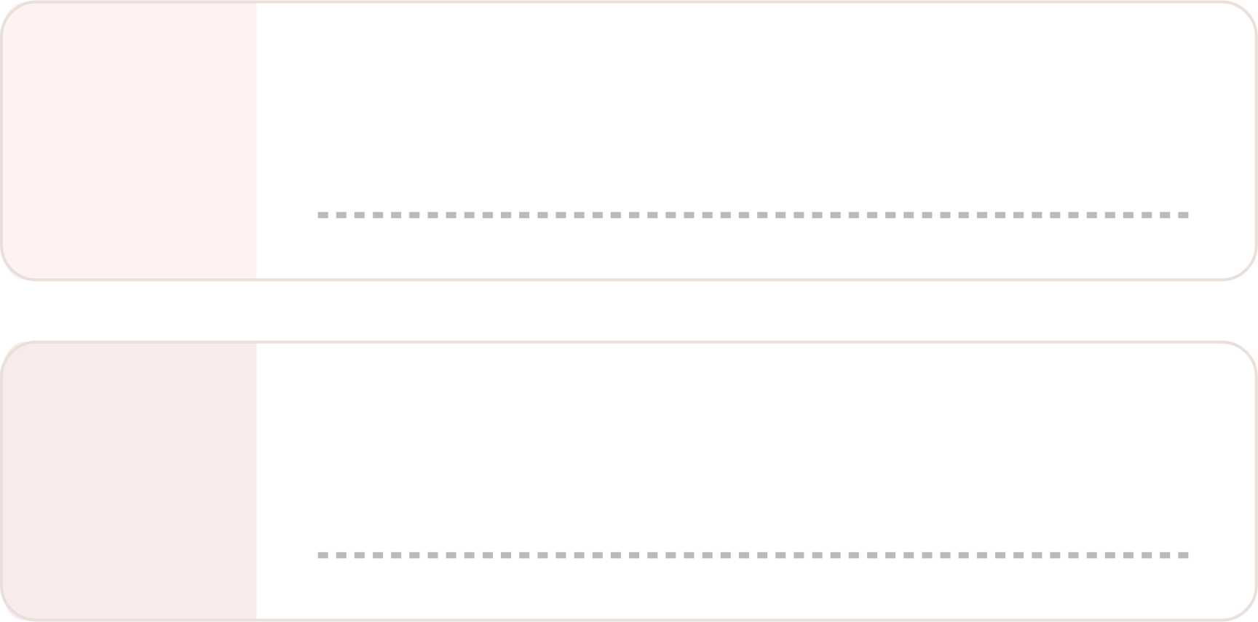

Introduction of the paper
Authors
Lai Kuan Cheong & Vanessa Chang,
Curtin University of Technology
Presented
18th Australasian Conference on
Information Systems (ACIS) in 2007
Enterprise Information Management
Utility company facing data quality issues
Context
Relevance in general:
Problem
Addressed
Ad-hoc data governance model
Lack of clear roles and responsibilities
Insufficient mandate for data quality initiatives
Ensuring data accuracy,timeliness,relevance,trustworthiness
Importance in regulatory compliance (Sarbanes-Oxley Act)
Improving organizational data management practices
Notes:
The paper titled "The Need for Data Governance: A Case Study" was authored by Lai Kuan Cheong and Vanessa Chang from the School of Information Systems, Curtin Business School, Curtin University of Technology. It was presented at the 18th Australasian Conference on Information Systems from December 5-7, 2007​​.
Problem Addressed
The primary problem addressed in the case study is the challenge of managing data effectively within large organizations, particularly in the context of compliance with regulations like the Sarbanes-Oxley (SOX) Act, which requires accurate and protected financial data. The study examines the relationship between IT Governance and Data Governance and highlights issues such as lack of clear roles, responsibilities, and mandates for data quality improvement initiatives​​​​
Relevance and General Importance
The relevance of this study lies in its exploration of Data Governance as an emerging trend in enterprise information management. The authors argue that good data quality is essential for effective data management and that this can be achieved through a structured Data Governance framework. This is crucial for organizations aiming to manage data as an enterprise asset, ensuring its accuracy, timeliness, relevance, completeness, trustworthiness, and contextual definition​​.

Slide 4
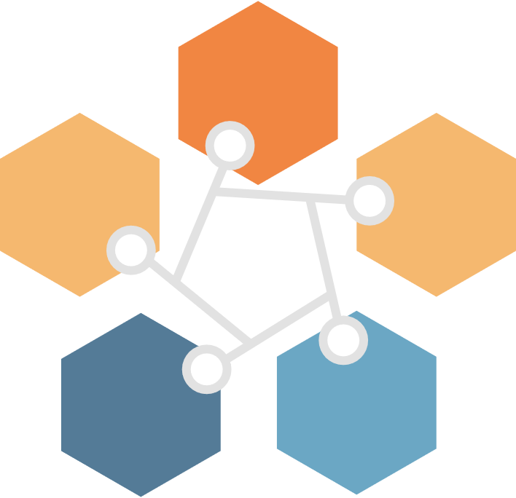

Data Governance
Data usability
How?
Data availability
Data integrity
Data
Governance
Based on internal
data standards and policies that also control data usage
Data lineage
Data security
Notes:
Let’s start with a basic question: What is Data Governance? Data Governance involves the policies, processes, and standards that ensure data is managed correctly across the organization. It’s crucial because it ensures data quality, supports regulatory compliance, and enhances decision-making and operational efficiency."
Data Governance consists of several key components: Each of these plays a vital role in maintaining the integrity and usability of data."
Data Governance is essential for managing data for every organization. A structured framework helps mitigate risks, ensures compliance, and improves overall data quality. Remember, the journey towards effective Data Governance is ongoing and requires continuous effort and improvement.

Slide 5



IT Governance
Key components:
📊
Strategic alignment
IT governance ensures IT investments align with business goals, manage risks, and deliver value.
💡
Value delivery
🔒
Risk management
🔧
Resource
management
Frameworks:
COBIT, ITIL, ISO/IEC 38500, COSO
📈
Performance
measurement

Slide 6

OVERVIEW OF THE PAPER
Objectives
Methods
Issues
Conclusion
To explore the relationship between IT Governance and Data Governance and to demonstrate the necessity of a formal Data Governance structure for effective data managemen
A case study methodology, focusing on a large organization that had adopted an ad-hoc Data Governance model. This approach allowed them to observe and analyze the practical challenges and outcomes associated with the implementation of Data Governance.
Key issues identified include the lack of clear roles and responsibilities, insufficient mandate for data quality initiatives, and the challenges in integrating data across disparate systems.
Effective Data Governance requires a structured framework that promotes collaboration between business and IT. It also emphasizes the need for organizations to recognize data as a critical asset and to implement comprehensive policies and procedures for data management.

Slide 7
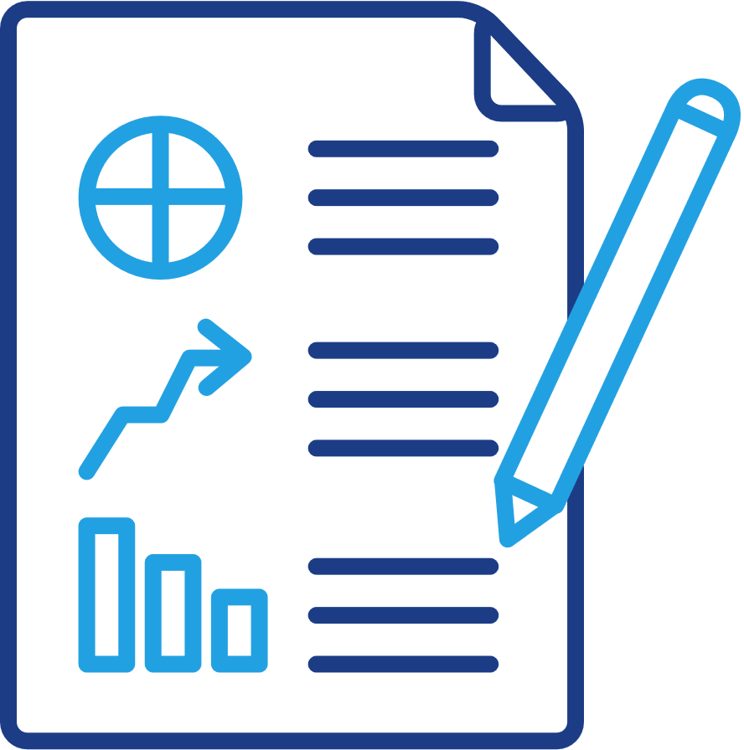


Case Study Scenario
The case study focuses on a large utility company that implemented an ad-hoc Data Governance model. The main aspects of the scenario include:
The company's struggle with data quality due to a lack of clear Data Governance policies.
Issues arising from disparate data systems and integration projects.
The need for a structured Data Governance framework to manage data effectively.

Slide 8

Company A Overview
Utility organization providing essential services
890k customers,1,850+ core staff, $3 billion asset
$2.23 million to increase network reliability by 25%
over 4 years
Network: 89,700 km, 950,000+ assets
Asset data in GIS and asset management system
Migrating to Ellipse ERP and replacing GIS system

Slide 9


Components of the Data Governance Framework
Organisational Bodies and Policies | Standards and Processes | Data Governance Technology
Governance Structure Data Custodianship User Group Charter Decision Rights Issues Escalation Process | Data definition and standard (Metadata Management) Third Party Data Extract Metrics Development and Monitoring Data Profiling Data Cleansing | Metadata Repository Data Profiling tool Data Cleansing tool

Slide 10

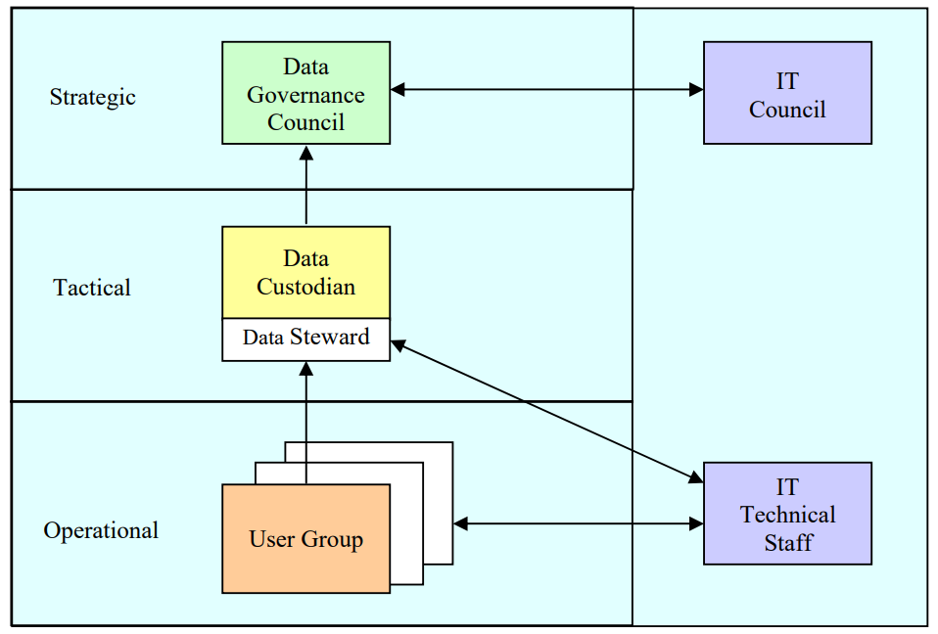
The Data Governance Structure
DGC
Endorsing policies, resolving cross divisional issues, engaging the IT council, etc.
Data Custodian
Responsible and accountable for the quality of asset data, solving issues raised in user group meetings.
User Groups
Data stakeholder, technical IT staff and data users.

Slide 11



TOPICS
01
Data Management Issues.
02
Control Compliance and Data Compliance
Success Factor for Data Governance
03

Slide 12




DATA MANAGEMENT ISSUES
Context
Example from Paper
Relevance
Data management supports data governance through tactical operations.
Challenges in data management arose from various projects like data integration, data warehousing, and business intelligence efforts
The data management issues highlighted are necessity for a data governance structure and framework to manage data effectively

Slide 13

The main business drivers of data governance is compliance, which is about following laws and rules to prevent wrong things from happening as well as detecting and mitigating incorrect actions of the past.
01
Control compliance involves following laws and rules to prevent issues. Data compliance ensures correct handling of data to meet regulations.
02
CONTROL COMPLIANCE AND DATA COMPLIANCE
Both control compliance and data compliance require the development and enforcement of policies and standards. Data governance provides the overarching framework within which these policies and standards are created, ensuring they are aligned with regulatory requirements and organizational objectives.
03
04
Control compliance ensures that all aspects of data management are controlled and monitored, while data compliance ensures specific adherence to data protection laws. Data governance integrates these elements to provide a holistic approach to data management, ensuring comprehensive compliance and effective data handling.

Slide 14



Success Factors
01
02
03
04
EXECUTIVE SPONSORHIP
DATA STANDARDS
COMPLIANCE MONITORING
PARTICIPATION
Clear roles and responsibilities should be a priority.
This ensures direction and authroity in the initiatives.
Corporate data has to be fit for purpose.
This helps maintain quality and consistency across the organization.
Periodic assessment of data management policies should be mandated.
Training might also be required to educate others about the value of data governance.
Data governance structure must include participation from all levels.

Slide 15


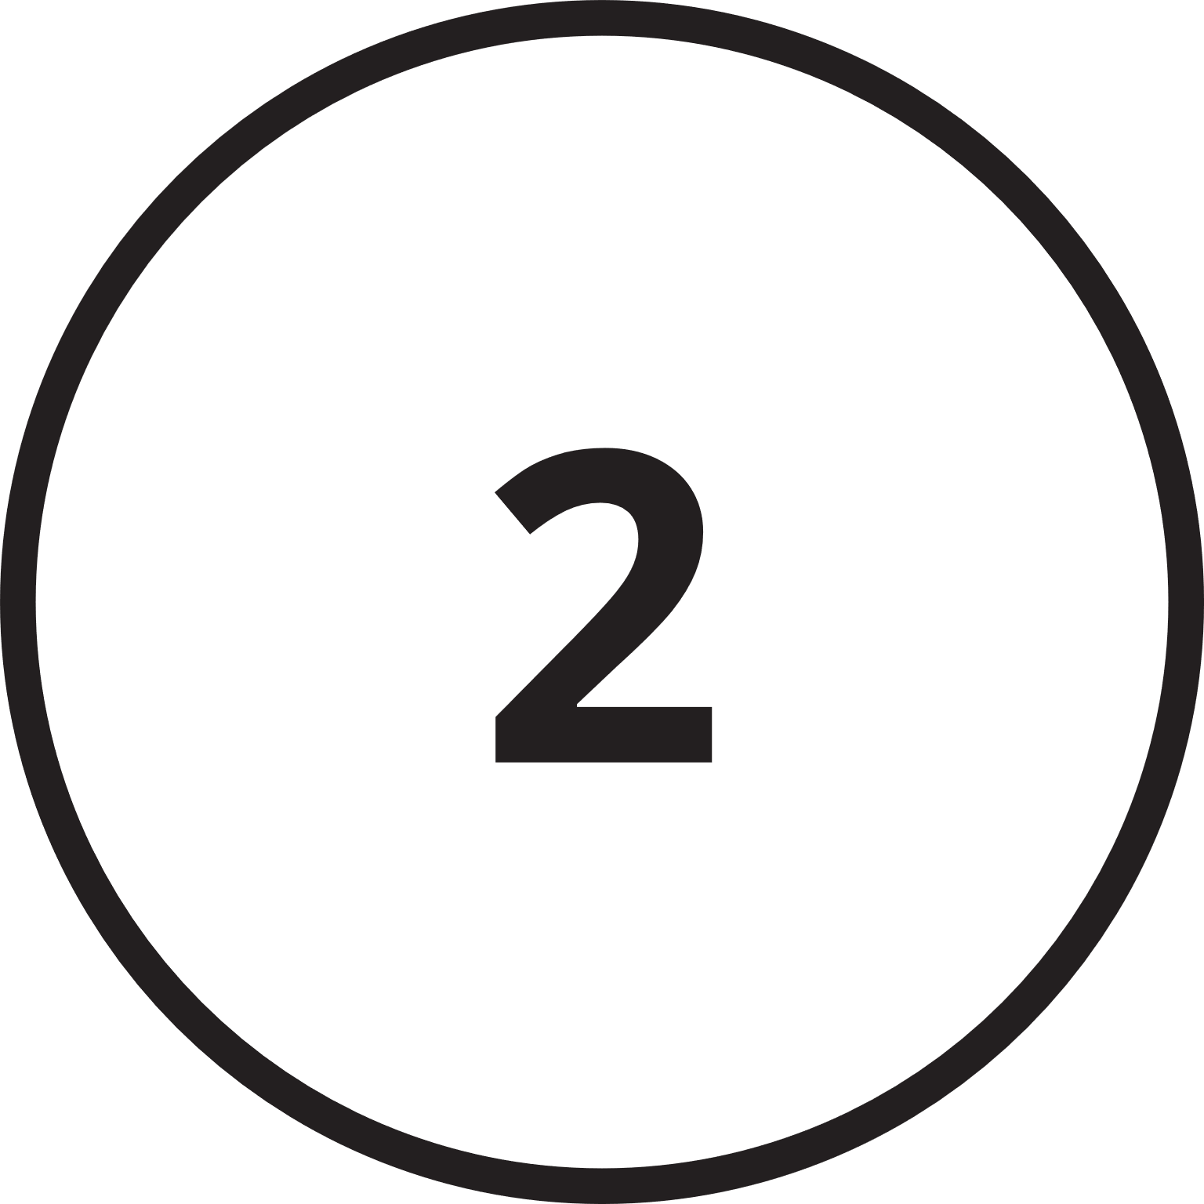
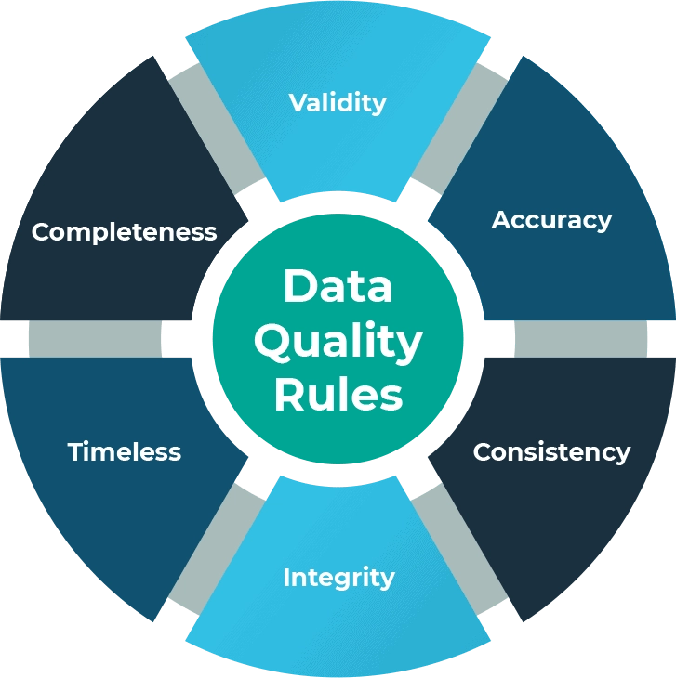
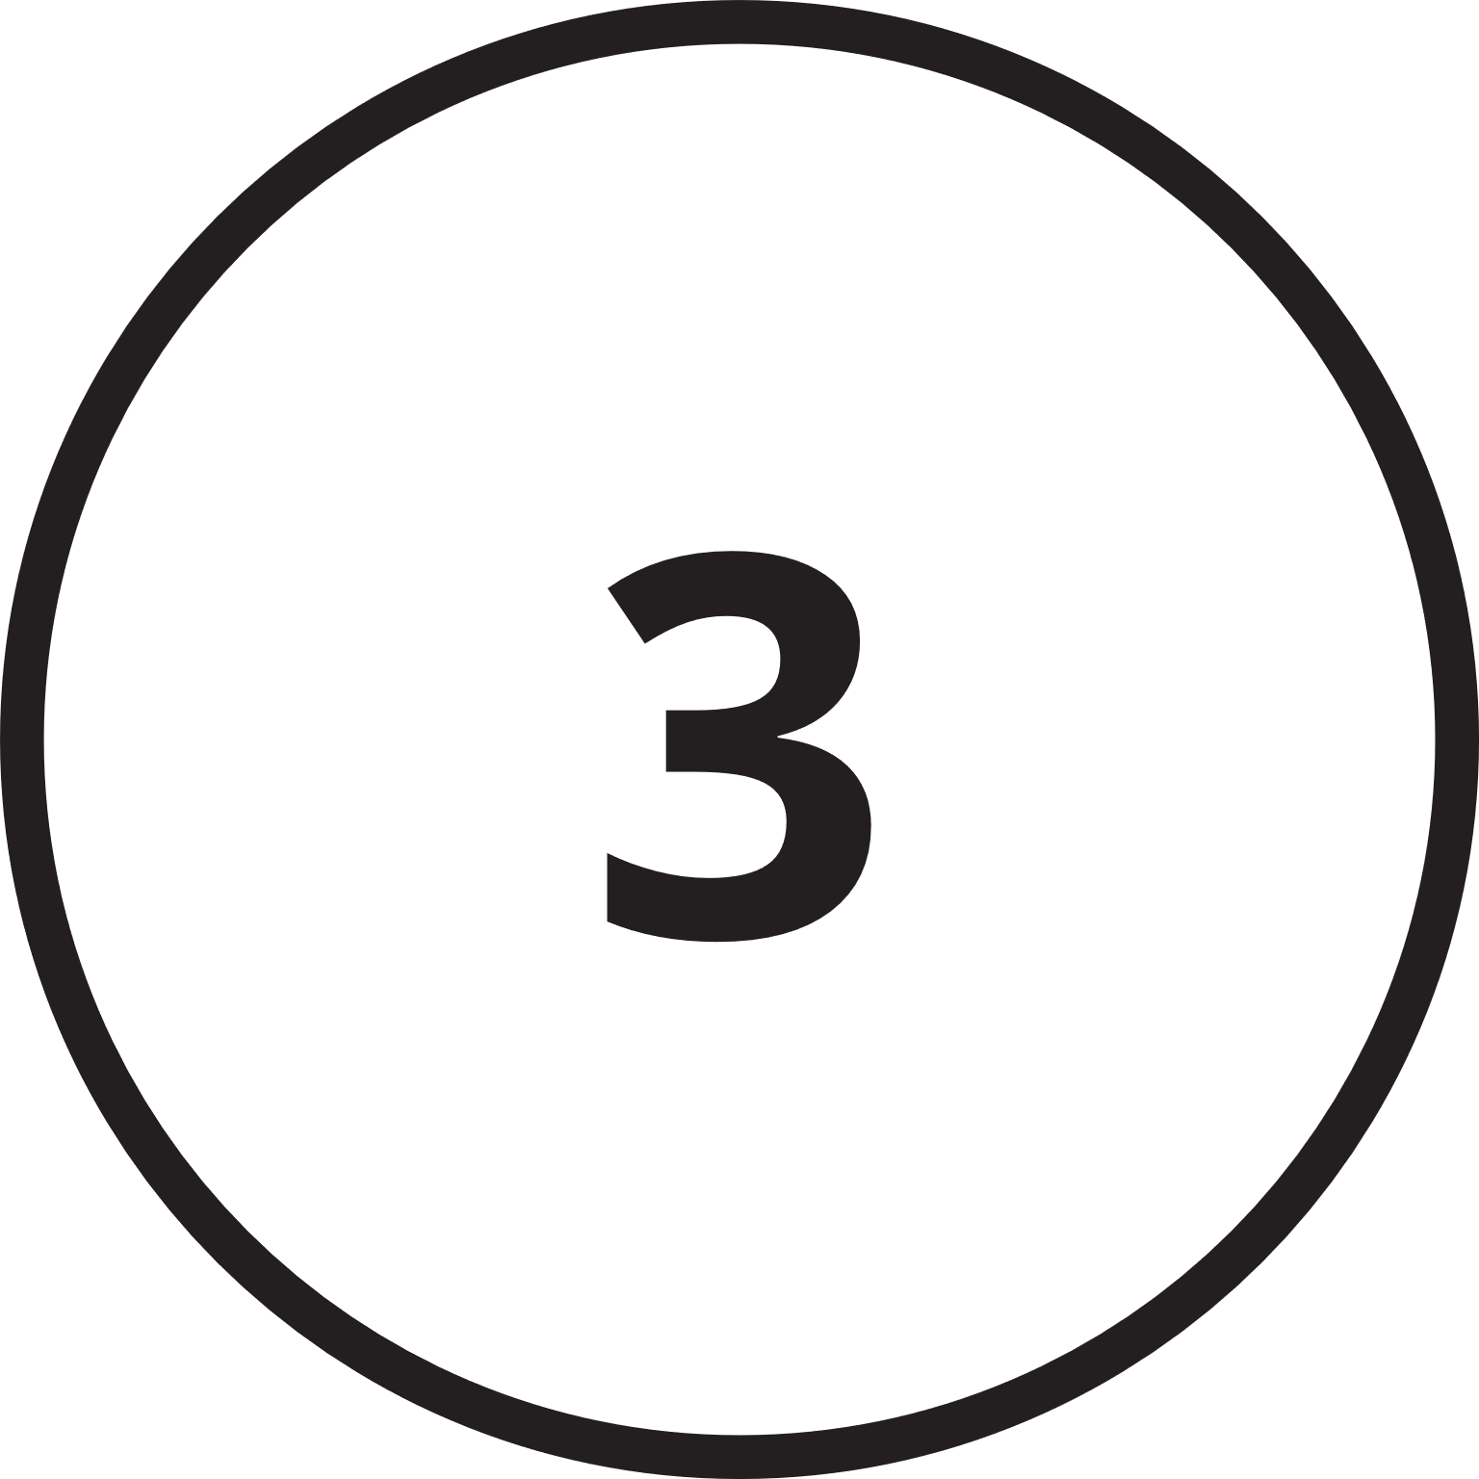
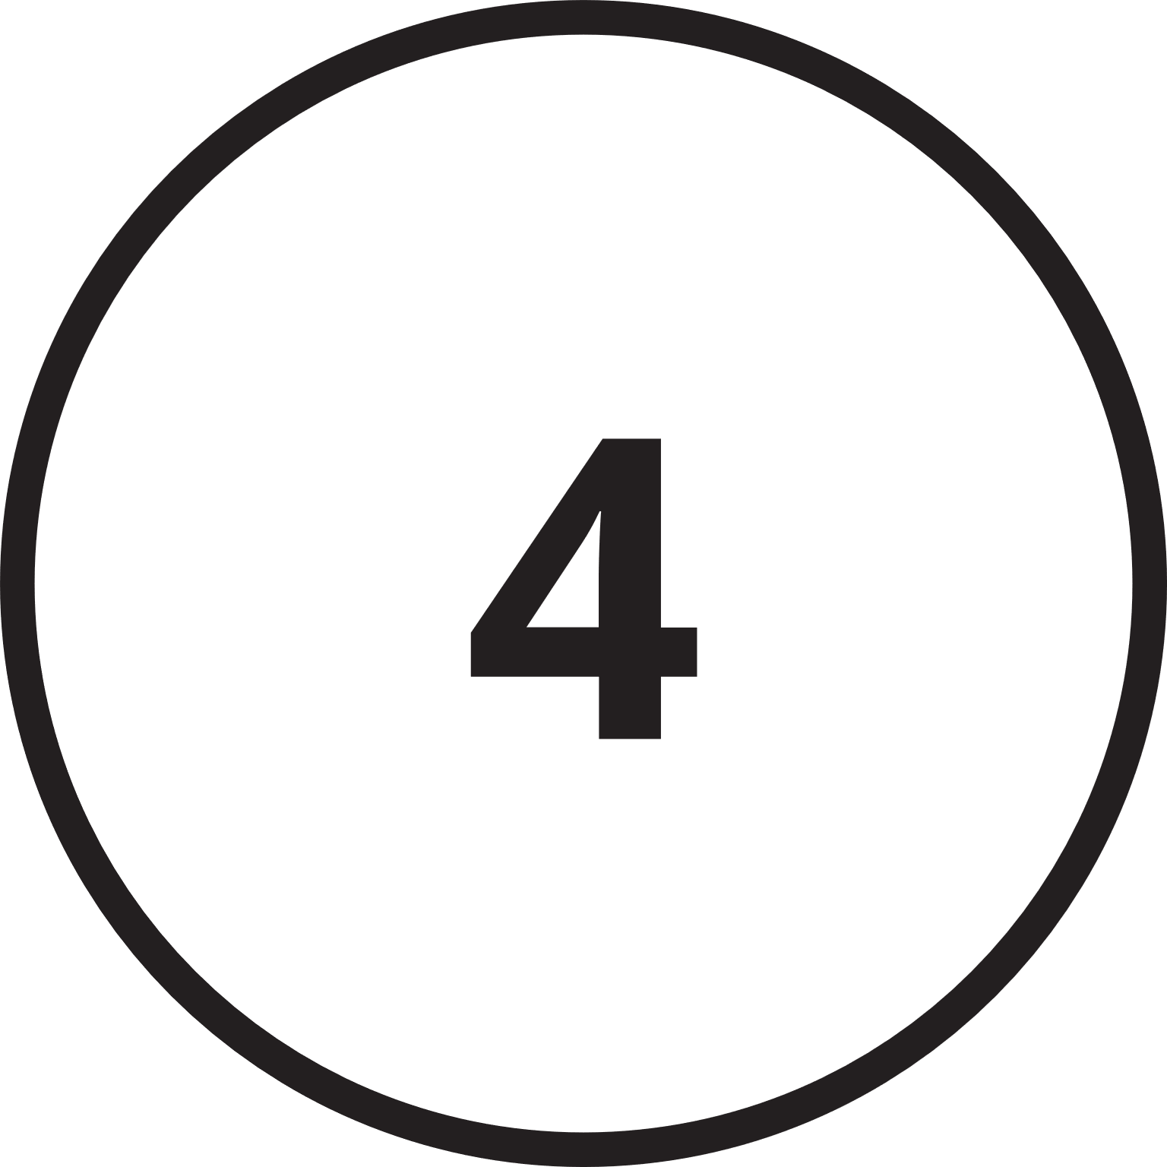


Data Quality Management
Accuracy: Correctness of data, free from errors
Timeliness: Data is up-to-date and available when needed.
Relevance: Data is pertinent to the task at hand.
Completeness: All necessary data is present.
Trustworthine﻿ss: Data is reliable and can be trusted.
Conte﻿xtual Definition: Data is understood within its context.

Slide 16
Establishing Data Standards : Defines these standards and policies, ensuring a structured approach to maintaining and improving data quality across the organization.
01
Trust and Stakeholder Confidence : Governance frameworks define the ethical use of data in decision-making processes, ensuring that data-driven decisions are fair, unbiased, and in the best interest of stakeholders. This ethical approach supports the goal of data quality assessments to provide accurate and trustworthy data for analysis.
02
RELATIONSHIP BETWEEN DATA QUALITY AND DATA GOVERNANCE
03
Accountability and Responsibility : Provides a framework for accountability, clearly defining roles and responsibilities for data quality management within the organization.
04
Decision-Making and Business Intelligence : Governance frameworks define the ethical use of data in decision-making processes, ensuring that data-driven decisions are fair, unbiased, and in the best interest of stakeholders. This ethical approach supports the goal of data quality assessments to provide accurate and trustworthy data for analysis.

Slide 17

CASE STUDY ANALYSIS
Context: Investigates the importance of data governance in relation to IT governance, especially concerning Sarbanes-Oxley (SOX) compliance.
Problem Addressed: Inefficiencies due to a lack of clear roles and responsibilities in data management.
Relevance: Emphasizes the necessity of a structured Data Governance framework for effective data management.

Slide 18
WHAT WAS DONE RIGHT
Creation of Data Management Team: Established a dedicated team for strategic and tactical direction on data-related issues.
Initial Data Governance Initiatives: Implemented a data strategy for quality improvement and appointed a dedicated project manager to liaise between business and IT.

Slide 19
WHAT WAS DONE WRONG
Lack of Clear Roles and Responsibilities: No defined data stewards or data owners, leading to projects lacking priority and sufficient budget allocation.
Ad-hoc Data Governance Model: Reactive approach rather than proactive data management; no direct access to source databases; data spread across disparate systems.

Slide 20
IMPROVEMENTS
Formal Data Governance Structure: Establish a Data Governance Council with clear decision rights and responsibilities; implement a scalable governance model to include all organizational divisions.
Enhanced Collaboration: Foster business and IT alignment at strategic, tactical, and operational levels; promote stakeholder engagement and consensus-building.

Slide 21


